Slide 1
Lecture 19: Homework #7 Review and In-Class Exercises

Slide 2
Homework #7 Review

Slide 3
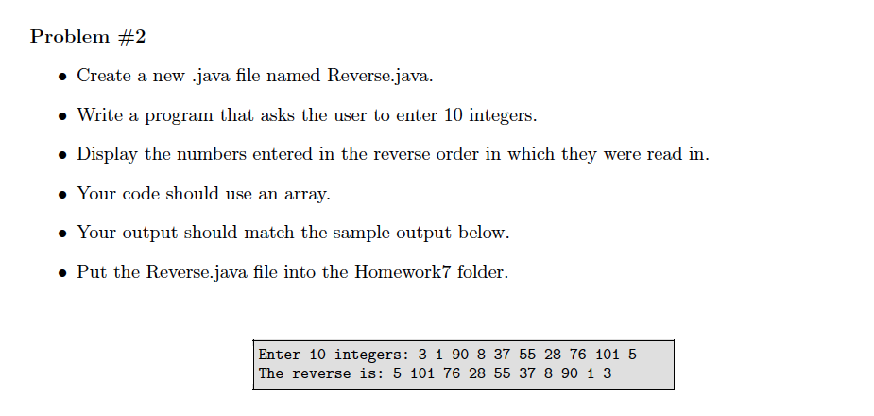

Slide 4
public static void main(String[] args)
{
Scanner input = new Scanner(System.in);
int[] array = new int[10];
System.out.print("Enter 10 integers: ");
for (int count = 0; count < array.length; count++)
{
array[count] = input.nextInt();
}
System.out.print("The reverse is: ");
for (int num = array.length - 1; num >= 0; num--)
{
System.out.print(array[num] + " ");
}
System.out.println();
}

Slide 5
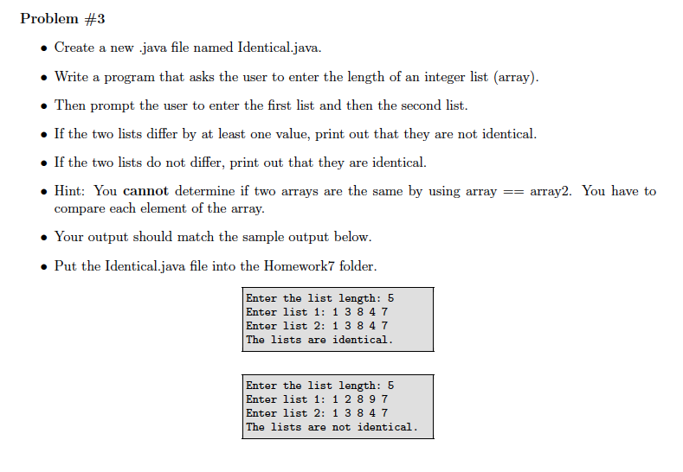

Slide 6
public static void main(String[] args)
{
Scanner input = new Scanner(System.in);
System.out.print("Enter the list length: ");
int size = input.nextInt();
int[] array1 = new int[size];
int[] array2 = new int[size];
System.out.print("Enter list 1: ");
for (int count = 0; count < size; count++)
{
array1[count] = input.nextInt();
}
System.out.print("Enter list 2: ");
for (int count = 0; count < size; count++)
{
array2[count] = input.nextInt();
}
. . .

Slide 7
. . .
int index = 0;
boolean isIdentical = true;
while (isIdentical && index < size)
{
if (array1[index] != array2[index])
{
isIdentical = false;
}
index++;
}
if (isIdentical)
System.out.println("The lists are identical.");
else
System.out.println("The lists are not identical.");
}
You have to start off
by assuming they are
identical and change
it to false if they’re not.
Why won’t it work the
opposite way?

Slide 8
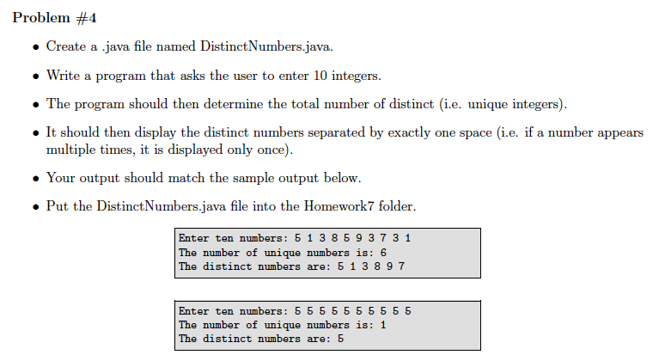

Slide 9
Scanner input = new Scanner(System.in);
int[] array = new int[10];
System.out.print("Enter 10 numbers: ");
for (int i = 0; i < array.length; i++)
{
array[i] = input.nextInt();
}
int[] uniqueNums = new int[array.length];
uniqueNums[0] = array[0];
int count = 1;
. . .
What if you have fewer unique numbers than the array length?

Slide 10
. . .
for (int i = 1; i < array.length; i++)
{
boolean isDistinct = true;
int j = 0;
while (j < count && isDistinct)
{
if (uniqueNums[j] == array[i])
isDistinct = false;
j++;
}
if (isDistinct)
{
uniqueNums[count] = array[i];
count++;
}
}
System.out.println("The number of distinct numbers is: " + count);
System.out.print("The distinct numbers are: ");
for (int i = 0; i < count; i++)
{
System.out.print(uniqueNums[i] + " ");
}
System.out.println();

Slide 11
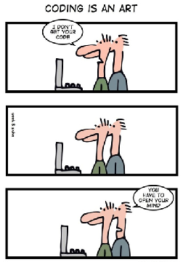
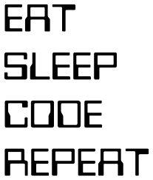

Homework #8 is posted and
due Wednesday, November 19th.

